Slide 1
The battle of Neighborhoods
IBM Capstone

Slide 2
Introduction
Finding the best neighborhood to open a restaurant in the New York City, Manhattan Borough

Slide 3
Business Problem
To locate the most appropriate area for an entrepreneur to open a successfully running and revenue generating restaurant in Manhattan, New York City
Question to address:
In the Manhattan borough of New York City, if someone is looking to open a restaurant, where would you recommend that they open it?

Slide 4
Data
Data Required:
List of neighborhoods in New York
List of neighborhoods in the most densely populated borough, Manhattan
Latitude and Longitude of these neighbourhoods
Top ten venues for these neighbourhoods to see the existence of different features that are helpful for opening an eatery, like a restaurant.

Slide 5
Data (Contd.)
Data Sources:
Json Data for New York neighbourhoods
Taken from : https://geo.nyu.edu/catalog/nyu_2451_34572
Extracting longitude and latitude information of these neighbourhoods using the GeoPy Geocoder package
Using Foursquare API to get venue details for these neighbourhoods

Slide 6
Methodology
The data from sources listed in the previous slide was carefully extracted, cleaned and the feature selection was made
First, the neighborhoods in the New York City were visualized and then one of the popular boroughs, Manhattan was chosen( based on its population and popularity as being the largest central business district).
Next, neighborhoods for Manhattan were visualized and processed
Foursquare API was used to explore the neighborhoods for the nearest venues
K-means algorithm was used to cluster the neighborhoods and subsequently find their top ten venues
The clusters were then visualized to draw a conclusion on a suitable area.

Slide 7
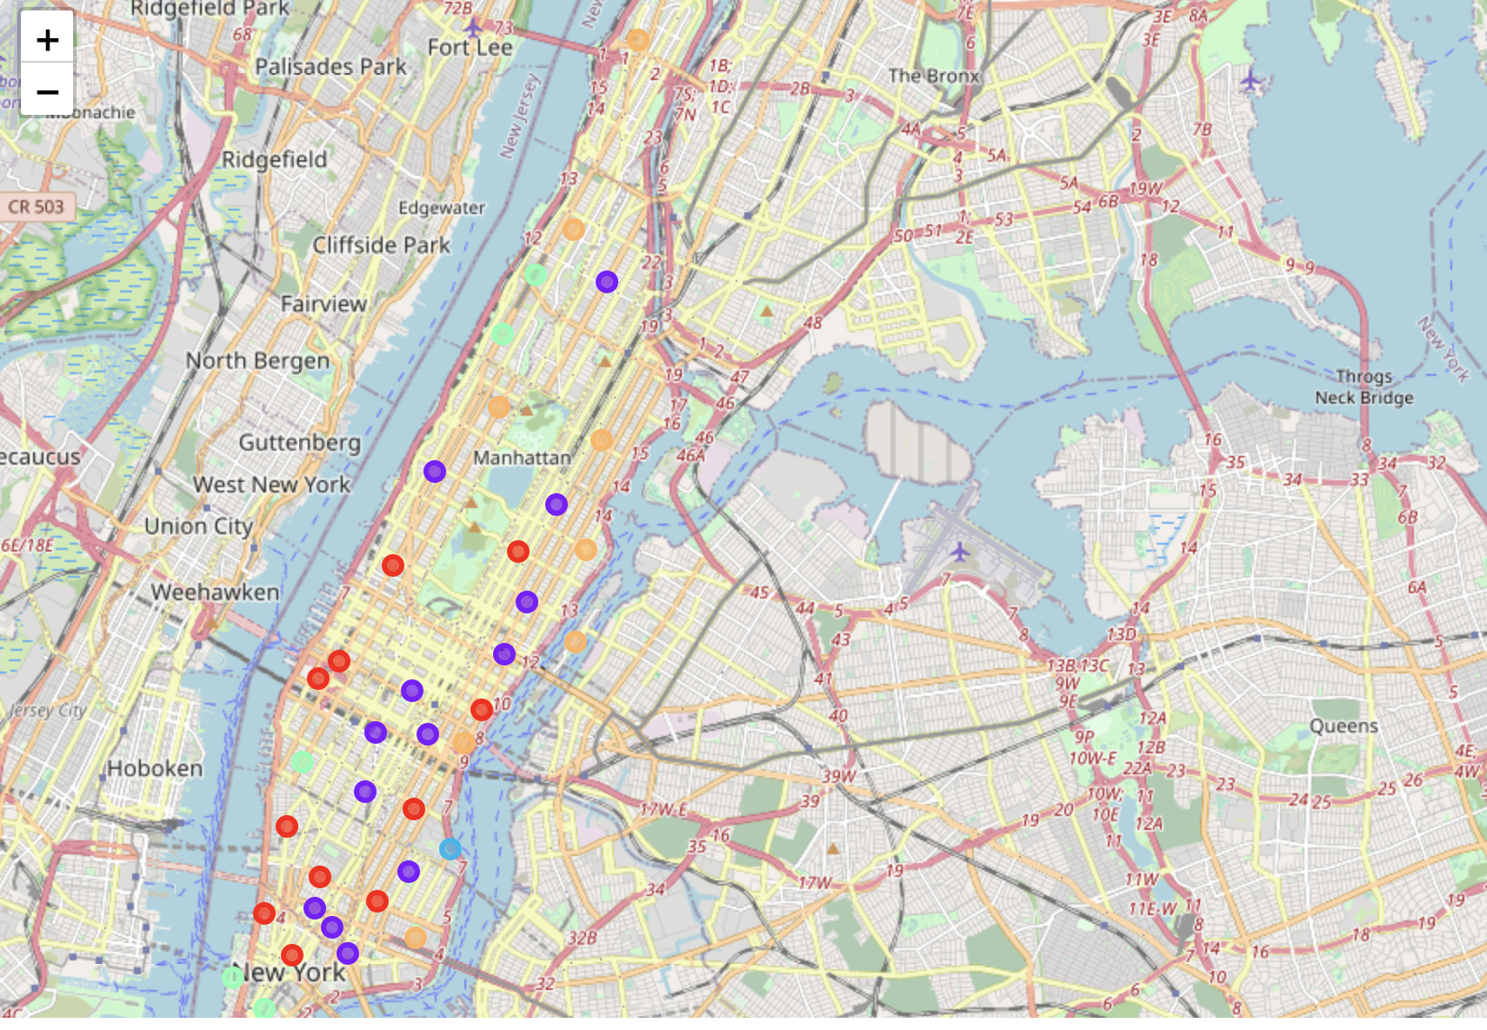
Results

Slide 8
Results (Contd)
The results from k-means clustering show that we can categorise Manhattan neighbourhoods into 5 clusters based on how many discriminating venue categories are there in each cluster.
Cluster 1-3: A lot of restaurants already in existence.
Cluster 4: No other restaurant but other venues like Park, Playground and recreational activity grounds in vicinity.
Cluster 5: Hardly any restaurants but a seafood restaurant in vicinity

Slide 9
Discussions
Most of the restaurants are available in Cluster 1 – 3 so opening another one in these areas could be very competitive and may not attract much business
Clusters 4 and 5 look suitable for consideration of opening a restaurant

Slide 10
Recommendations
Most of the restaurants are in Clusters 1-3.
Looking at the nearby venues, Stuyvesant Town would be quite suitable for opening a new restaurant.

Slide 11
Conclusion
The neighbourhoods in cluster 4 offer the most preferable location to open a new restaurant.
Findings and observations from this project will help the relevant entrepreneurs to zero in on high potential areas while avoiding the areas in other clusters that already have restaurants as top 10 venues. This should provide useful information to stakeholders who are looking for a suitable area for opening a restaurant in a suitable location in Manhattan, New York.

Slide 12
Thank You

